Slide 1
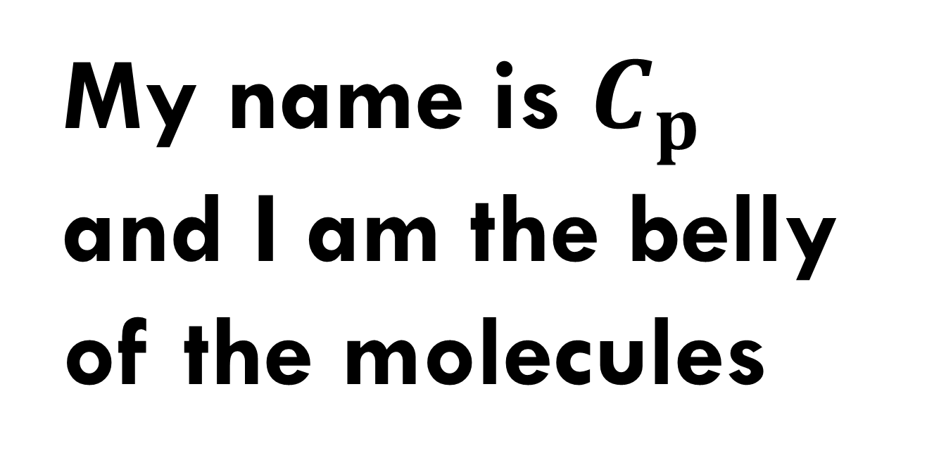
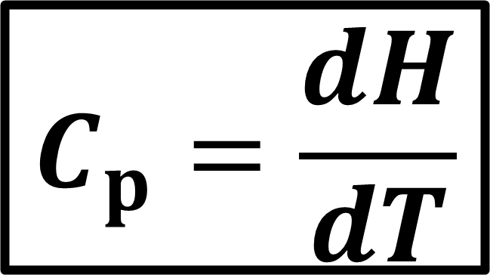
$$C_{p}=\frac{dH}{dT}$$
My name is $C_{p}$ and I am the belly of the molecules

